Slide 1
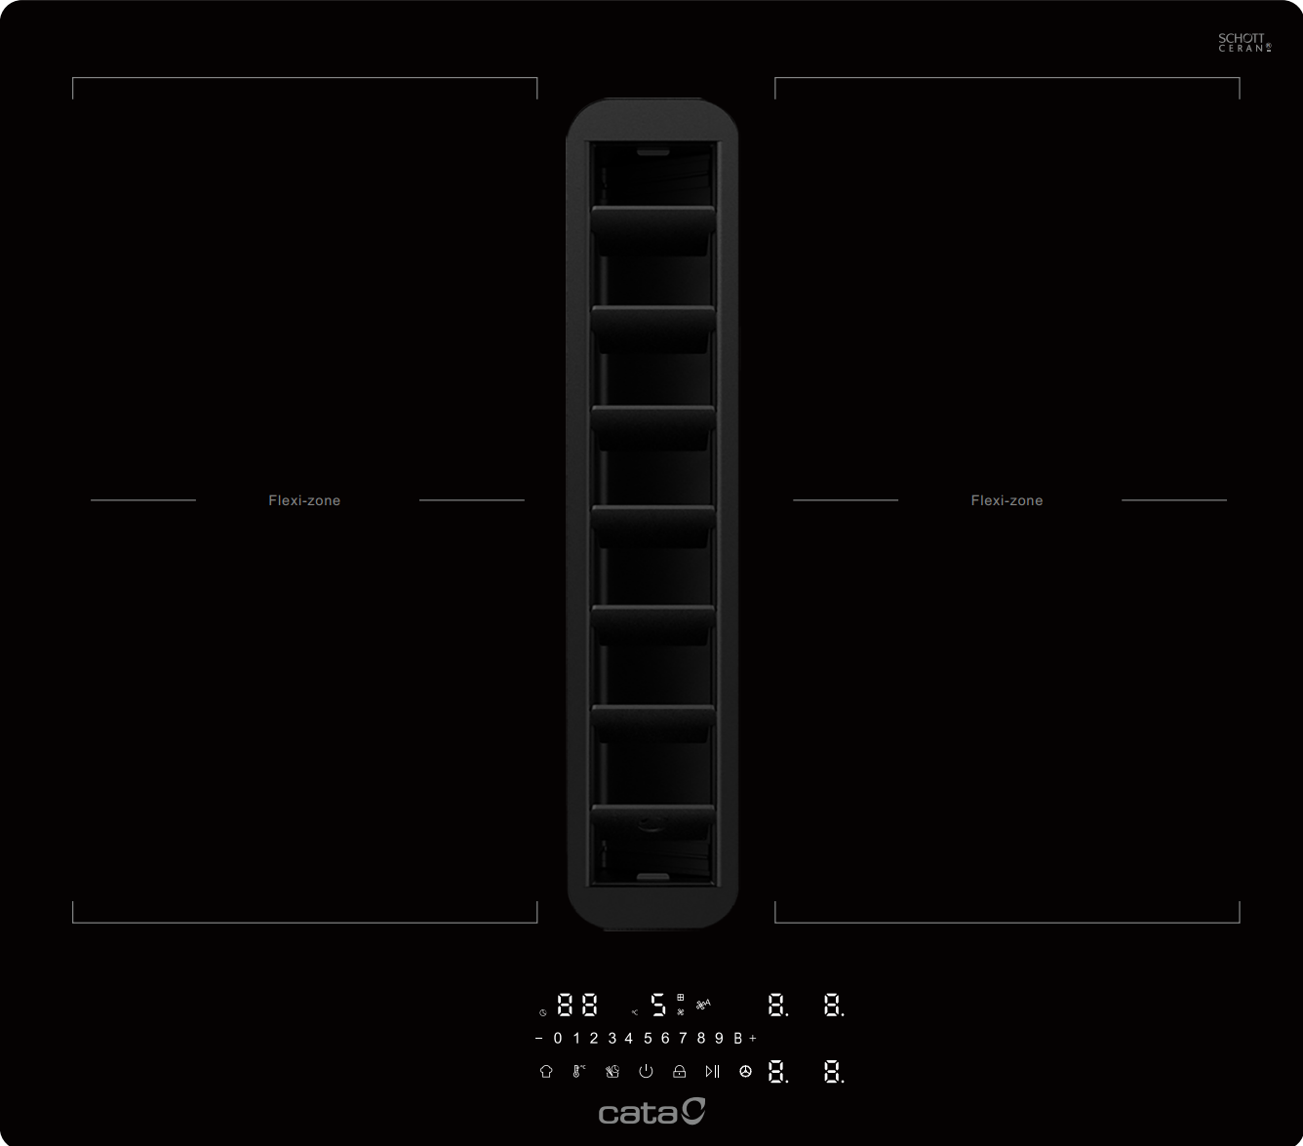





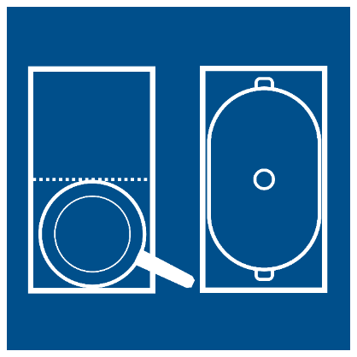















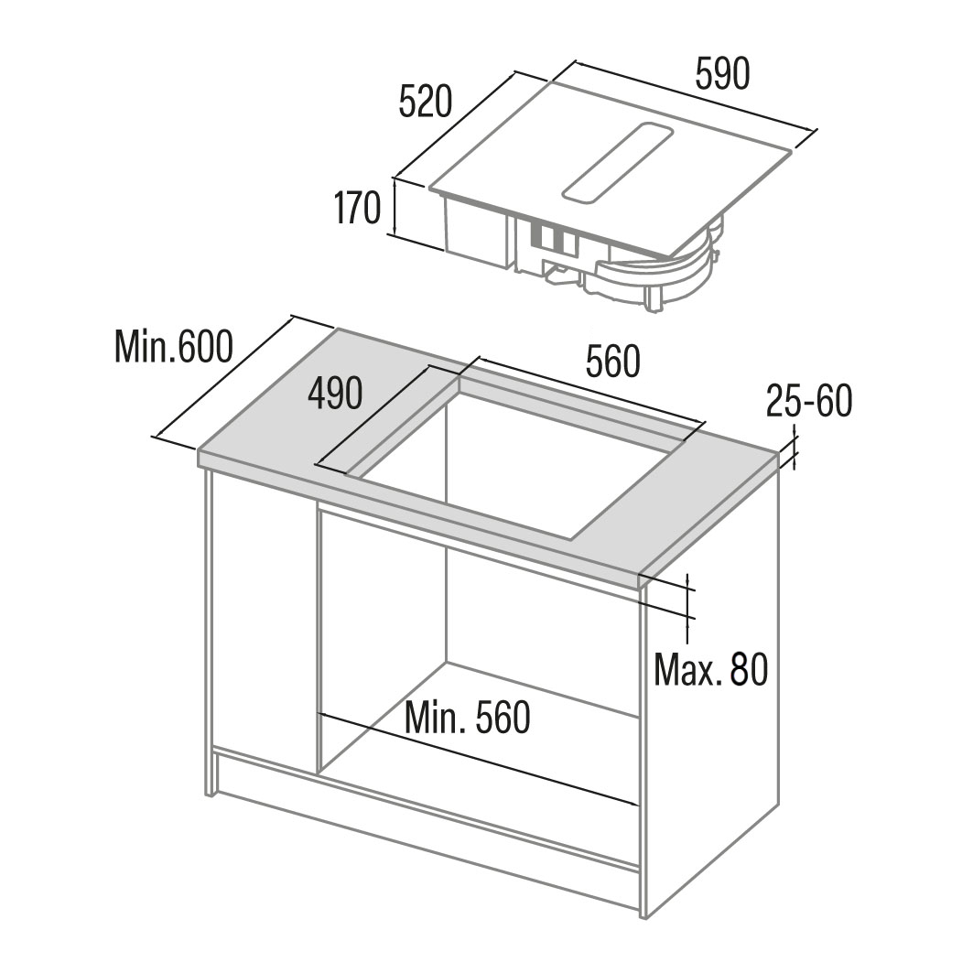
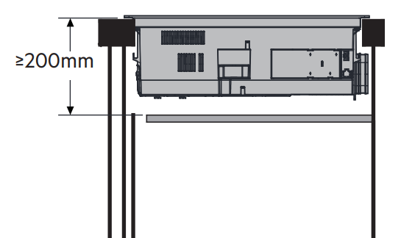
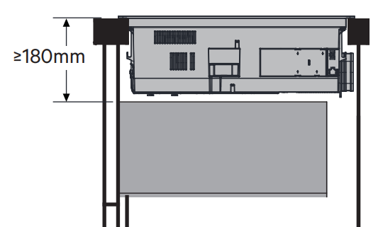
CATDD60CHF
Main Features
Brand | Cata
Hob Type | Vented Induction
Heat Source | Electric
Colour / Finish | Black
No. of Zones (Flex Zones) | 4 (2)
Max Cooking Power | 7.2kW
No. of Power Settings | 9 + 2 Boost
User Controls | Hidden Touch Slider LED Display
No. of Fan Speeds | 5 + 1 Boost
Max Airflow / Boost Airflow | 491m³/h / 673m³/h
Max Noise / Boost Noise | 68dB (A) / 74dB (A)
60CM 4 ZONE FLEX VENTED INDUCTION HOB
Characteristics
Cooking Surface | Black Glass (Schott Ceran)
Display Colour | White
Grille Colour | Black
Timer | 1-99mins
Zone 1 (Front Left) | 210x190mm, 2300/3000W Boost
Zone 2 (Rear Left) | 210x190mm, 2200/2600W Boost
Zone 3 (Rear Right) | 210x190mm, 2200/2600W Boost
Zone 4 (Front Right) | 210x190mm, 2300/3000W Boost
Flex Zones | 2x 210x380mm 3000/3600W Boost
Cooking Functions | Pause, Recall, Pot Move, Pasta/Rice
Warming Functions | Melt (42°C) / Defrost (55°C) / Keep Warm (70°C) / Simmer (90°C)
Chef Mode | Chef, Grill, BBQ
Residual Heat Indicator | 3 Level
Safety | Pot Detection, Child-Lock, Key-Lock, Over Temperature Safety Shutoff, Cooling Fan, Small Article Detection, Auto Shutdown Protection
Motor Rating | 170W
Airflow (Min/Max/Boost) | 238 / 491 / 673 m³/h
Noise Level (Min/Max/Boost) | 51 / 68 / 74 dB (A)
Grease Filter | Aluminium Mesh
Washable Filter / Dishwasher Safe | Yes / Yes
Secondary Filter (not included) | 4x Regenerative Ceramic Blocks
Venting Kits (sold separately) | Extraction - KITVENTSL1X Recirculation - KITVENTSL1R
Min. Worktop Thickness | 25 mm
Fixings | Spring Clips
Worktop Seal | Yes
EAN
8422248618182
Technical Data
Rated Voltage | 220-240V ~ 50/60Hz
Max Power | 7,400W
Supply Connection | 32A
Cable / Plug (Fitted) | 1.0m / -
Energy Efficiency Class | A+
Energy Consumption of Hob | 192.5 Wh/kg
Dimensions & Weights
Product (WxDxH) | 590 x 520 x 170 mm
Built-In Niche (WxD) | 560 x 490 mm
Packed Product (WxDxH) | 671 x 570 x 250 mm
Net / Gross Weight | 15.9 kg / 19.3 kg

